Slide 1
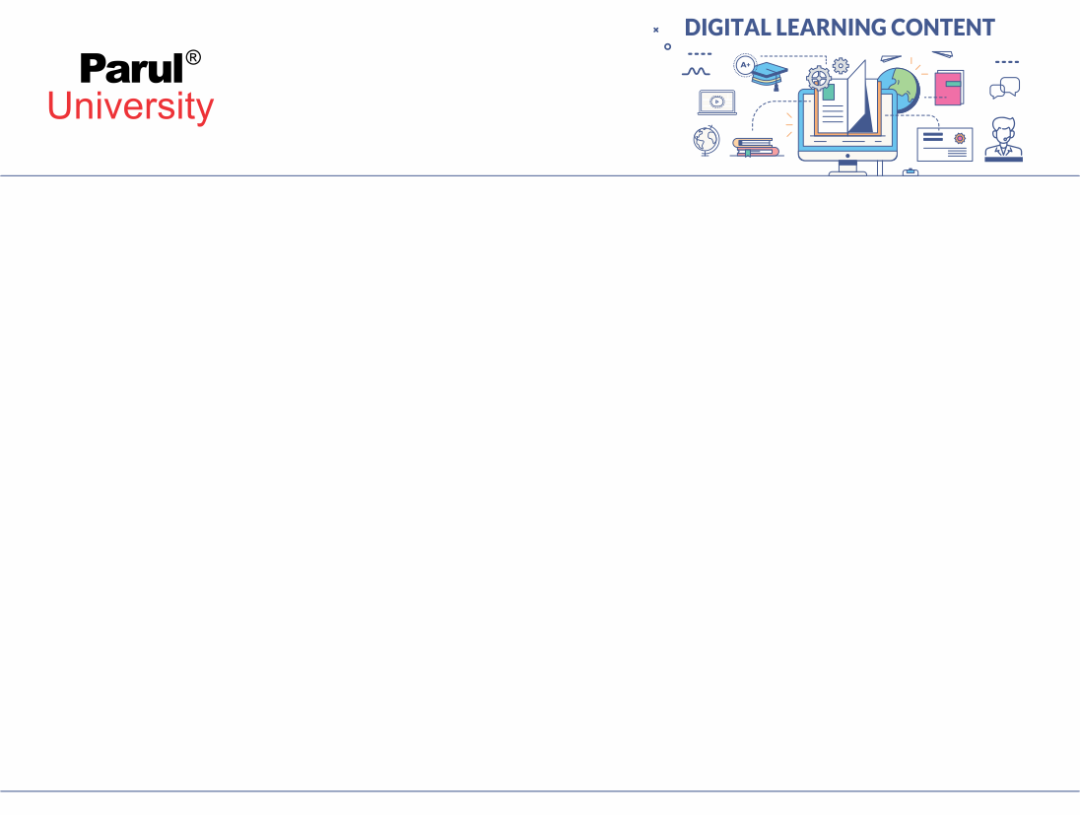

Packages
Package is a container for classes.
A java package is a group of similar types of classes, interfaces and sub-packages.
Package in java can be categorized in two form:
1) built-in package :- Existing Java package (ex: java, lang, awt, javax, swing, net, io, util, sql etc)
2) user-defined package:- Java package created by user(ex: p1,mypack1,p2 etc.)
Packages are stored in a hierarchical manner and are explicitly imported into new class definitions.
You can define classes inside a package that are not accessible by code outside that package.
You can also define class members that are only known to other members of the same package.

Slide 2
Advantage of Java Package
Java package is used to categorize the classes and interfaces so that they can be easily maintained.
Java package provides access protection.
Java package removes naming collision.
To make searching/locating and usage of classes easily.

Slide 3
How to Create Package
You can create a package by just including a package command as the first statement in a Java source file. Any classes declared within that file will be the member of that specified package.
The package statement defines a name space in which classes are stored. If you omit the package statement, the class names are put into the default package, which has no name.
Syntax: package packagename;
EX : package MyPackage;
OR package java.awt.image;
OR package packg1.packg2.packg3;

Slide 4
Java uses file system directories to store packages.
For example, if you have package MyPackage then the .class files for any classes you declare to be part of MyPackage must be stored in a directory called MyPackage.

Slide 5
Import a package
Syntax:
import pkg1[.pkg2].(classname | *);
Ex:
builtin package: import java.util.Date;
or import java.io.*;
User define package : import p1.D;
or import p1.*;

Slide 6
Example
package p1;
import java.io.*;
public class A
{
public static void main(String args[])
{
System.out.println(“Hello”);
}
}
-> save file with A.java
-> Compile:
javac -d . A.java
-> Run
java p1.A
A.java

Slide 7
Example
package p2;
import p1.*;
Import java.io.*;
public class A
{
public static void main(String args[])
{
B obj = new B();
obj.hi();
}
}
package p1;
public class B
{
public void hi()
{
System.out.println(“Hello”);
}
}
A.java
B.java

Slide 8
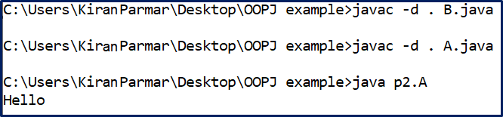
OUTPUT

Slide 9
Example
package date;
import java.util.*;
import java.time.LocalDate;
public class DateExample
{
public void display()
{
LocalDate today = LocalDate.now();
System.out.println("Current System Date="+today);
}
}
package date1;
import date.DateExample;
class SysDate
{
public static void main(String st[])
{
DateExample d=new DateExample();
d.Display();
}
}
DateExample.java
SysDate.java

Slide 10
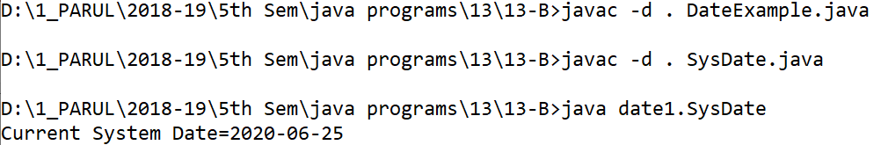
OUTPUT

Slide 11


www.paruluniversity.ac.in

